Slide 1
Soroban DeFi with Artificial Intelligence

Slide 2
Project Outline:
As we all know, blockchain is the one of the sophisticated technology to store our data and other things in very safest manner.
In this project, I created the DeFi application using Soroban Smart contract with Artificial Intelligence, which gives intelligence to the smart contracts.
We can create the intelligent DeFi Application to reduce the workload of the blockchain.
For that, we going to employ the DAO(Decentralized Autonomous Organization) to train our dataset with more security.
To operate DAO, I introduce the new consensus Algorithm called “Proof of Web”.

Slide 3
Modules Included:
Deploying Contracts
Lending and borrowing (with AI)
Decentralized Chatting
Concept of DAO with Proof of Web

Slide 4
Workflow Diagram:
Deploying Contract
Initialize Lender with some tokens
Depositing tokens to the Liquidity Pool
Borrower Borrowing token
DAO
Cross check the Borrower’s eligibility
Send Chat messages to the IPFS
Train the AI model with Proof of Web
Chatting can draw way for decentralized chatting with IPFS

Slide 5
Concept of DAO(Proof of Web)

Slide 6
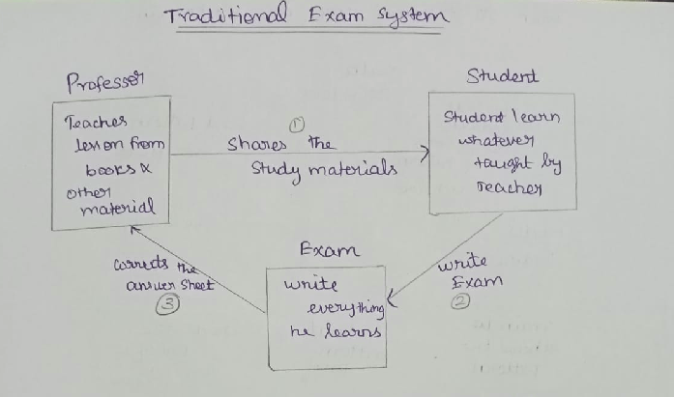

Slide 7
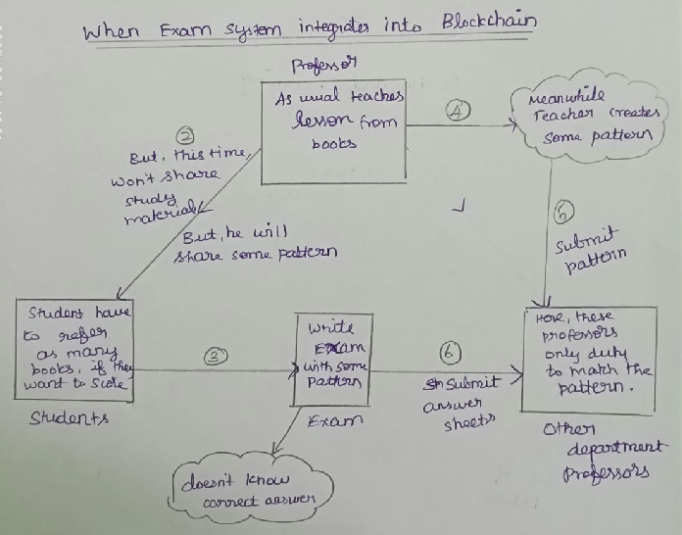

Slide 8
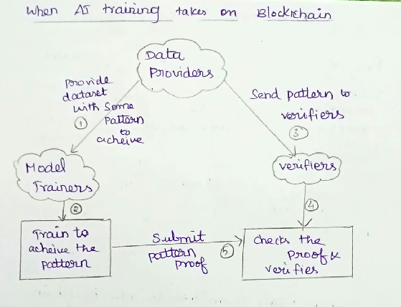

Slide 9
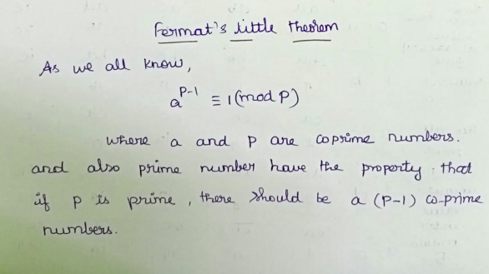

Slide 10
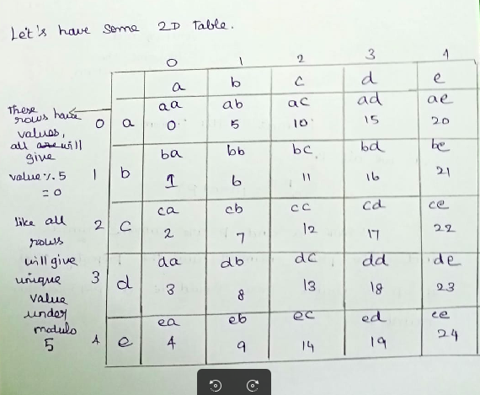
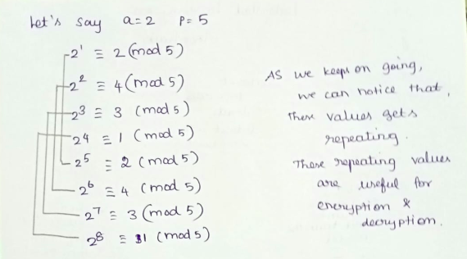

Slide 11
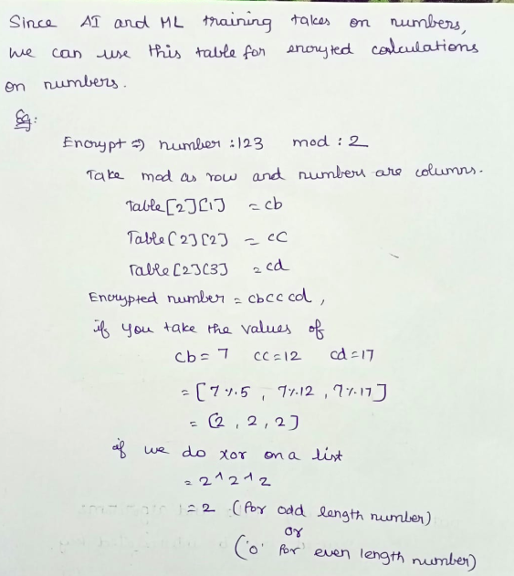

Slide 12
Process Flows:
DAO query the data from the blockchain for training.
The initial weights value and bias value as encrypted(initially zero)
Split into chunks, and send to the peers.
Peers will train the model, and return to the dataset providers.
By the way, Consensus algorithm itself checking internally the integrity of mod values, if anything changes training will be stopped.
Finally, data providers taking aggregation of all output provided by the input.

Slide 13
Where the calculations are done?
These calculations are done by the consensus algorithm we developed.
Consensus Algorithm takes number as input and encrypt.
These encrypted numbers are only read by algorithm with the help of fermat’s table.
These fermat’s table are not same for all ML/AI training, as the data owners keeps on changing the prime numbers, these are randomly shuffled.
When we have large prime numbers, and prime factors are the mod input, it is nearly impossible to find the original numbers.
Moreover, it operates on plain numbers, inside the algorithm.
Let’s see some demo!

Slide 14
Our Algorithm is still in progress :-
It can perform all operation to some certain digits, it is not optimized for floating numbers and ‘E’ notation numbers.
It is high level language implementation. We can optimize into more efficient code by doing some bit manipulation and all.
We can make it fast by storing frequent numbers and encrypted strings in stack to reduce the access time.

Slide 15

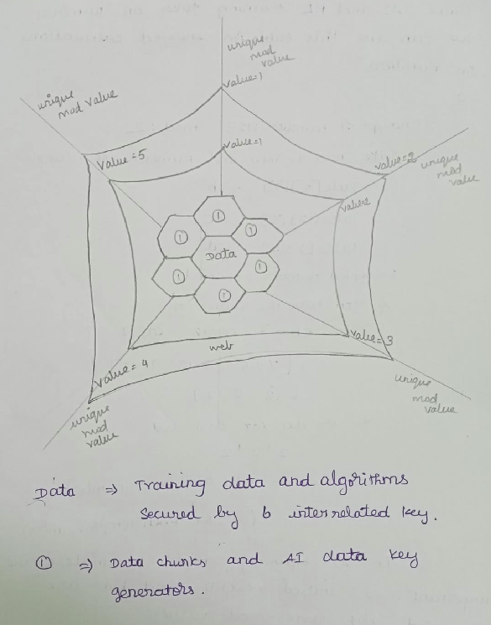

Slide 16
Way to run the project:
Just install vscode, and live server extension.
Install the all the requirements packages, from the file requirements.txt which is inside the pythonSDK folder. Just run pip3 install -r requirements.txt
Install Soroban CLI from the official Soroban docs.
I have three contracts folder, chat, defi and sb-token. Just enter into all the folder and run => “cargo test”, “soroban contract build” commands.
To start the frontend, just open the frontend folder in vs code, and select init.html file, you can find the “Go Live” option in the right corner. Click that, it will start the front end.

Slide 17
Way to run the project:
To run the backend, just enter into the pythonSDK folder.
Note that, create account in pinata and create API keys and fill in the .flaskenv file. Otherwise it will leads to some errors.
After filling flaskenv file, just run command “flask run –debug”. It will start the backend API services.
I just trained the Borrow approval ML training with some duplicate data and straightforward without using the DAO I mentioned, just because to understand the workflow.

Slide 18
Way to run the project:
To run the ML training in DAO with peer, open 6 Six terminals, navigate to network folder.
Because, 1 for server and other 5 is peers. It is socket programming. But in real time blockchain network we don’t need a server.
Start the server by “python3 server.py”
Press 1 to start the server, it will start listening.
Start the peers by “python3 client.py”
Press 1 to start peers, it will automatically start syncing.
In the server, press 2 for training. You can see all peers receiving the chunks and started training and return the model weights.

